Slide 1
Logging
The errors that occurs may have to be logged so that they can be looked at and traced at a later point of time.
Usually the errors are logged in the Windows Event Log.
Security Exception occurs if "Full control" is not enabled to EventLog for ASPNET account. One way to get around this problem is to start Visual Studio with Run As Administrator permission.
The web server that are hosted in a dedicated server machine (not shared as in web farm etc.) can use Event Log.
EventLog can be opened in Administrative Tools section of Control Panel

Slide 2
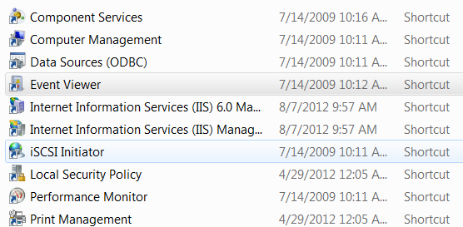
Logging

Slide 3
System.Diagnostics.EventLog
This class is used to log an entry into event log
The steps to work with event log are usually
1. Determine if an event source is registered on the local computer static bool SourceExists( string source )
2. If event source is not registered, register it static void CreateEventSource( string source, string logName )
3. Initialize a new instance of the EventLog class and associate the instance with the log.
EventLog() - constructor and using the Source property log can be associated or EventLog(String src) can be used
4. Write log entry
void WriteEntry(string msg,EventLogEntryType t) 20

Slide 4
Example: logging events
Run the VS as administrator.
Let us add the events in the Page_Error event handler. void Page_Error(object sender, System.EventArgs e1) { Exception e = Server.GetLastError(); string s = "Sorry, an error occurred detalis of which is given below. <BR>" + e.Message; Response.Write(s); string SiteLogName = "MyASPLearningSite"; if(System.Diagnostics.EventLog.SourceExists( SiteLogName) == false){ System.Diagnostics.EventLog.CreateEventSource( SiteLogName, "Application"); }

Slide 5
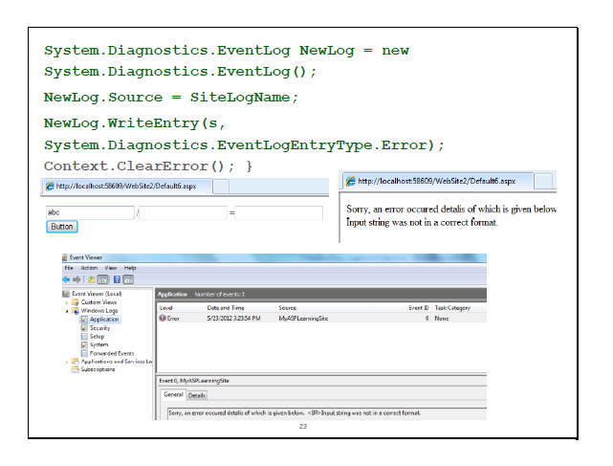

Slide 6
Tracing
Tracing is an activity of recording the diagnostic information related to a specific web page that is being executed on the web server.
Tracing Methods:
On the Page
When this method is used, the trace output is displayed on the page that is executed
Out of Page
In this method, the tracing results are not displayed on the page but these are stored on the web server and in the root folder of the application in a file named as trace.axd. After execution of the pages, this file can be viewed on the browser. For example http://yourApplicationroot/trace.axd

Slide 7
Tracing
The tracing can be enabled at two Levels:
Page Level
Application Level
Working with Page Level Tracing
The page level tracing can be enabled using page directive
To enable and disable the tracing dynamically
To
<%@ Page Language=“c#" AutoEventWireup="False" Trace="True" Codebehind="TraceTest.aspx.cs" Inherits="TracingExample.Test"%>
protected void Page_Load(object sender, EventArgs e)
{
Trace.IsEnabled = true;
}

Slide 8
Tracing
Working with Application Level Tracing[Settings required in web.config]
<trace enabled="true" pageOutput="true" requestLimit="10" traceMode="SortByTime" localOnly="true" />
Enabled :
Enable or Disable tracing for entire application.
PageOutput :
If this attribute value is set to true then the trace output will be displayed on the page. If value of this attribute is set to false trace, then the trace output can be retrieved using browser. Typically the URL would be http://<yourAppliccationRoot>/trace.axd.
RequestLimit:
This attribute is active only when the PageOutput attribute value is set to false. This attribute defines the number of page requests that are to be traced.
TraceMode:
To manage the order of the trace output, this attribute is used. For Example SortByTime, SortByCategory etc.
localOnly:
Set this attribute to "false" if you want access the trace log from any client. Otherwise the log will be displayed on local machine only.

Slide 9
Tracing
Trace Output
When the trace is enabled we get the trace output. This output contains lot of details, some of the sections are as follows:
Request Details - This section talks about the basic information like session ID, Request Time, Type of HTTP Request, HTTP response details.
Trace Information - This section provides messages and categories. Also, this section will display the log that we have displayed using Trace.Write() or Trace.Warn().
Control Tree - This section displays the information about controls that are used within the page that is being executed.
Cookies Collection - If the page is using any cookies, this section will display the details of those cookies.

Slide 10
Tracing Methods
Trace Methods we can access using Trace object which is the object of page class
Trace.Write (Sample trace output / Custom message)
Trace.Warn (Sample trace output / Warning / Custom message)
.When Warn method is used the trace output will display the given message in red.
Trace.IsEnabled –To enable or disable trace for a page.

